Slide 1
London’s crime and safest areas
Capstone project – the battle of neighbourhoods

Slide 2
Introduction
Before moving to a new area we need to know a bit about the place we’re going to live or work in. it’s crucial to know which areas are the ones with the venues we like and are also safe
In this presentation, the crime statistics for London will be presented. The goal is to identify the safest borough of London, explore its neighbourhoods, and detect the 10 most common venues in each neighbourhood

Slide 3
Data used:
A crime statistics dataset for london
A Wikipedia page with the list of London’s boroughs
A Wikipedia page with the list of the neighbourhoods of Kingston upon thames

Slide 4
Methodology
Only crime data from 2016 were considered (the dataset contains data from 2008 to 2016)
The table with the list of London’s boroughs was cleaned and merged with the dataset containing the crime data
Since Kingston upon Thames is the safest borough, a new dataset and a map were created with its neighbourhoods and corresponding coordinates (obtained using Google Maps API geocoding)
Using Foursquare API, all the venues within a 500 meters radius of each neighbourhood were found
By calculating the frequency of each venue in each neighbourhood, the 10 most common venues per neighbourhood were found
K-means clustering was used to cluster the neighbourhoods with similar venues. The 15 neighbourhoods were clustered into 5 clusters

Slide 5
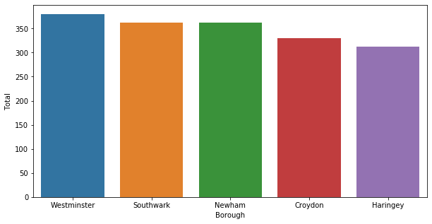
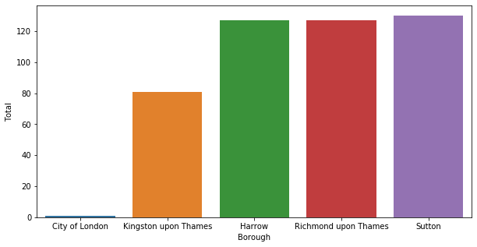
results
Boroughs with the highest crime rate
Boroughs with the lowest crime rate

Slide 6
Maps of Kingston upon Thames’ neighbourhoods, before clustering and after clustering

Slide 7


 | Neighborhood | Borough | Latitude | Longitude | Cluster Labels | 1st Most Common Venue | 2nd Most Common Venue
6 | Kingston Vale | Kingston upon Thames | 51.431850 | -0.258138 | 0 | Grocery Store | Sandwich Place
7 | Malden Rushett | Kingston upon Thames | 51.341052 | -0.319076 | 0 | Grocery Store | Garden Center
14 | Tolworth | Kingston upon Thames | 51.378876 | -0.282860 | 0 | Grocery Store | Restaurant
 | Neighborhood | Borough | Latitude | Longitude | Cluster Labels | 1st Most Common Venue | 2nd Most Common Venue
1 | Canbury | Kingston upon Thames | 51.417499 | -0.305553 | 2 | Pub | Park
4 | Hook | Kingston upon Thames | 51.367898 | -0.307145 | 2 | Fish & Chips Shop | Bakery
5 | Kingston upon Thames | Kingston upon Thames | 51.409627 | -0.306262 | 2 | Café | Coffee Shop
9 | New Malden | Kingston upon Thames | 51.405335 | -0.263407 | 2 | Gastropub | Sushi Restaurant
10 | Norbiton | Kingston upon Thames | 51.409999 | -0.287396 | 2 | Pub | Food
12 | Seething Wells | Kingston upon Thames | 51.392642 | -0.314366 | 2 | Indian Restaurant | Coffee Shop
13 | Surbiton | Kingston upon Thames | 51.393756 | -0.303310 | 2 | Coffee Shop | Pub
Examples of tables
with clustered neighbourhoods
and their venues

Slide 8
discussion
Kingston upon Thames is the safest borough of London
This borough has 15 neighbourhoods which could be clustered in specific groups, according to the type of venues they offer
The three neighbourhoods in cluster 1 seem to be ideal for whoever wants to live near a grocery store
The neighbourhood in cluster 2 could not be clustered with any other neighbourhood, since tea rooms and wine shops seem to be its commonest venues
The neighbourhoods in cluster 3 are certainly the ones to be recommended to people who like going out for a drink and some exotic food
The neighbourhood in cluster 4, as the one in cluster 2, doesn’t seem to be similar to others, since its main venue is a train station
The two neighbourhoods in cluster 5 are recommended for those who love going to the gym

Slide 9
conclusion
Data science can help a person making an important decision as is buying a house, opening a business, or renting a new apartment
With code, we could learn which borough of London is the safest and we could virtually explore the safest borough by dividing it in specific areas that have similar venues in common

